Slide 1
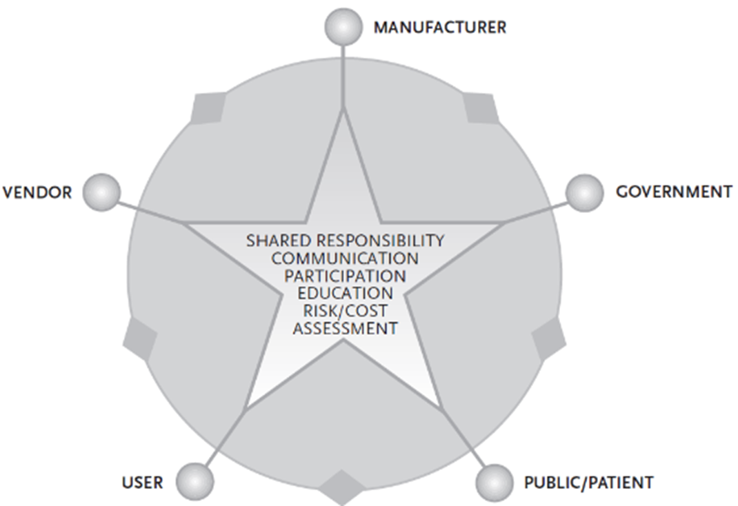
Participants in ensuring the safety of medical equipment
Manufacturer
Vendor
User
Government
Public
Communication and interactions between participants
17.1.3 Identify participants in ensuring the safety of medical equipment
17.1.4 Explain the role of each participant in ensuring safety
17.1.5 Identify areas of shared responsibility
Unit C 17.1 Medical Equipment Safety
Module 279-17-C Regulations, Standards and Ethics
©
dr. Chris R. Mol, BME, NORTEC, 2017

Slide 2
Participants in ensuring the safety of medical equipment
1. Participants that directly manage phases in the equipment life cycle: Manufacturer, Vendor and User
2. Government that is ultimately responsible for making the regulations that must ensure safety
3. The Public (patient) that is the direct beneficiary (‘customer’) of equipment safety.
All five play critical roles in ensuring the safety of medical devices
©
Concepts of Safety and Risk Management
dr. Chris R. Mol, BME, NORTEC, 2017

Slide 3
Responsibilities of stake holders: examples
It is the task of the medical device manufacturer to prove that a device is clinically effective.
For example, if a device is intended for pain relief, the manufacturer needs to possess objective, scientific evidence, such as clinical test results, that the device does in fact relieve pain.
It is also the task of the medical device manufacturer to demonstrate that
all possible risks associated with the device are identified and adequately addressed.
A role of the regulatory authority (‘government’) is
to ensure that the manufacturer has effectively implemented the risk management process
©
Concepts of Safety and Risk Management
dr. Chris R. Mol, BME, NORTEC, 2017

Slide 4
Manufacturer
The Manufacturer is responsible for the three phases:
design/development/testing,
manufacturing,
packaging and labelling.
that lead to a product being ready for the market.
The manufacturer, the creator of the device, must ensure that the device is manufactured to meet the required standards of safety and performance.
That means that the medical device manufacturer must be able to demonstrate that
all possible risks associated with the device are identified and adequately addressed.
In addition, sometimes the manufacturer is also responsible for:
after sales support: training, maintenance, spare parts delivery.
disposal: take back the product to dispose of it.
©
Participants in Safety
dr. Chris R. Mol, BME, NORTEC, 2017

Slide 5
Manufacturer: design/development/testing
The term “user error” is defined as an action that has a different result than that intended by the manufacturer or expected by the operator. User error may result from a mismatch between variables, for example the operator, device, task, or environment.
By incorporating human factor engineering principles in design, and appropriate training for users, the risk of user errors can be minimized.
The manufacturer must be able to demonstrate that he has implemented this approach…
©
Participants in Safety
dr. Chris R. Mol, BME, NORTEC, 2017

Slide 6
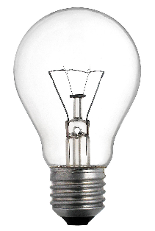
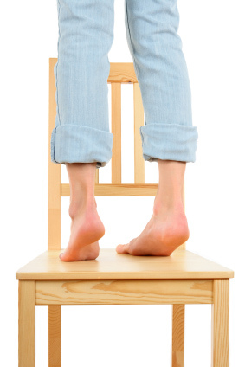
The Purpose of a device: intended use
Every device has a designed Purpose
can have undesirable side effects
which may be foreseeable…
may be used for other purposes,
which may not always be foreseen…
The manufacturer is responsible for safety when the product is used for its designed purpose
the users are mostly responsible for any other use…..
©
Participants in Safety
dr. Chris R. Mol, BME, NORTEC, 2017

Slide 7
Manufacturer: Manufacturing
Good Manufacturing Practices (GMP) contains an enormous amount of regulations on how a manufacturing operation needs to be run to deliver consistent quality and continuous improvement of processes.
For example: descriptions must be available of
all (construction) work,
all testing work,
when to approve a product,
when to repair or throw away,
how suppliers are managed,
how product problems in the field should be investigated in manufacturing,
…..
©
Participants in Safety
dr. Chris R. Mol, BME, NORTEC, 2017

Slide 8
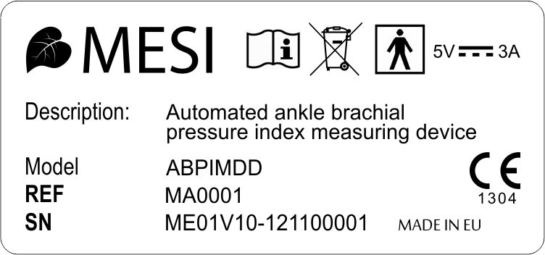
Manufacturer: Packaging and Labelling
Medical devices must be packaged so that the products pose little risk to individuals that handle the product, even if the medical device is biohazardous. Shipping is one of the hazards a medical device and its packaging must survive.
Well-sealed packaging is essential for those medical devices that must be maintained sterile.
Labelling is crucial in identifying the medical device and specifying instructions for its proper use. As for drugs, mislabelling of medical devices can result in serious consequences for the user. Hazard warnings or cautions and clear instructions for use are very important.
©
Participants in Safety
dr. Chris R. Mol, BME, NORTEC, 2017

Slide 9
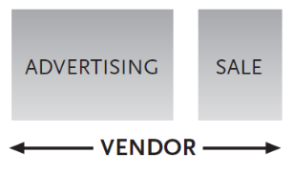
Vendor
The Vendor provides the interface between the product and the user. The term Vendor includes importers, distributors, retailers and
manufacturers who sell medical equipment.
He/she should make certain that the products he/she sells comply with regulatory requirements. I.e. he has to check the manufacturer !
©
Participants Roles
dr. Chris R. Mol, BME, NORTEC, 2017

Slide 10
Vendor: Advertising
Vendors should not make misleading or fraudulent claims about their products or issuing false compliance certificates.
Used or refurbished devices should be clearly labelled as such.
Medical device marketing and advertising are regulated to prevent misrepresentation of a medical device and its performance.
©
Participants Roles
dr. Chris R. Mol, BME, NORTEC, 2017

Slide 11
Vendor: After Sales Support
Vendors should provide after-sale service.
Medical devices often require specialized training from the manufacturer for proper use and service; therefore, the vendor should make training a condition to the manufacturer or importer in accepting to sell the device. In turn, vendors should take responsibility in supporting or training their customers.
Participating in post-market surveillance (receiving and reporting customer complaints/incidents) is critical for ensuring medical device safety and performance. The vendor must fulfil these obligations specified by the regulatory authority. For example, the vendor must make arrangements for processing complaint/incident reports relating to medical device safety and performance.
In the case of home-use medical devices, the vendor should recognize that the device being sold might end up in the hands of a lay-person who may need special instructions for the proper use and maintenance of the device. In this situation, efforts must be made to provide non-technical instructions and to educate and help the customer.
©
Participants Roles
dr. Chris R. Mol, BME, NORTEC, 2017

Slide 12
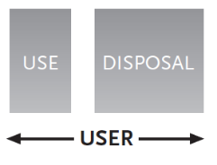
User: use
The User is usually a professional in a health care facility, but may also be the patient.
The user should make sure that he/she has qualifications and training in the proper use of the device, and is familiar with the indications, contra-indications and operating procedures recommended by the manufacturer.
It is crucial that experience gained with medical devices be shared with other users, the vendor and manufacturer to prevent future problems. This can be done by reporting any incidents to a coordinating centre from which warnings can be issued.
When using medical devices, users should always bear in mind that the safety and health of the patients are in their hands. The user has the responsibility to employ the medical device only for the intended indications (or to assure that any non-indicated use of the medical device does not compromise the safety of the patient and other users).
The user also has the responsibility to ensure proper maintenance of medical devices during active use.
©
Participants Roles
dr. Chris R. Mol, BME, NORTEC, 2017

Slide 13
User: disposal
The user has the responsibility to ensure safe disposal of obsolete medical devices
Disposal of certain types of devices should follow specific and stringent safety rules. For example, devices that are contaminated after use (e.g. syringes) or devices that contain toxic chemicals, can present hazards to people or the environment and must be disposed of properly.
©
Participants Roles
dr. Chris R. Mol, BME, NORTEC, 2017

Slide 14
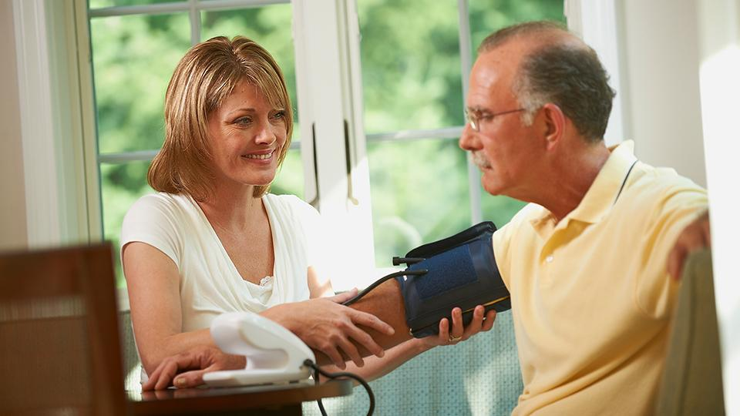
Public
The public are the ultimate beneficiary of medical devices.
They should be fully aware that all devices carry a certain risk and that they can help to promote safety and performance through self education and by putting “customer pressure” on manufacturers to comply with standards.
Medical devices are increasingly available for home use, making the Public also the User. Purchasers of home-use medical devices should be aware of associated risks and take the responsibility to become educated in the functions and correct operating procedures for those devices.
©
Participants Roles
dr. Chris R. Mol, BME, NORTEC, 2017

Slide 15
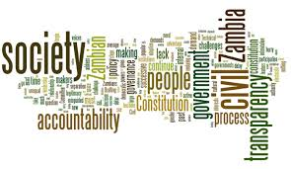
The government
The government has the responsibility to oversee the efforts of manufacturers and vendors and ensure that medical devices sold or made available in the country are safe and effective.
It should provide leadership in creating healthy cooperation among stakeholders in establishing policies and regulations that are fair and clear to all.
Policies and regulations should be reviewed periodically to respond to changes in technologies by incorporating appropriate amendments.
©
Participants Roles
dr. Chris R. Mol, BME, NORTEC, 2017

Slide 16
Shared Responsibility
The ideal conditions that will ensure the safety and performance of medical devices require shared responsibility by all stakeholders.
This requires continuous good
communication and cooperation symbolized in the picture.
©
Participants in Safety
dr. Chris R. Mol, BME, NORTEC, 2017

Slide 17
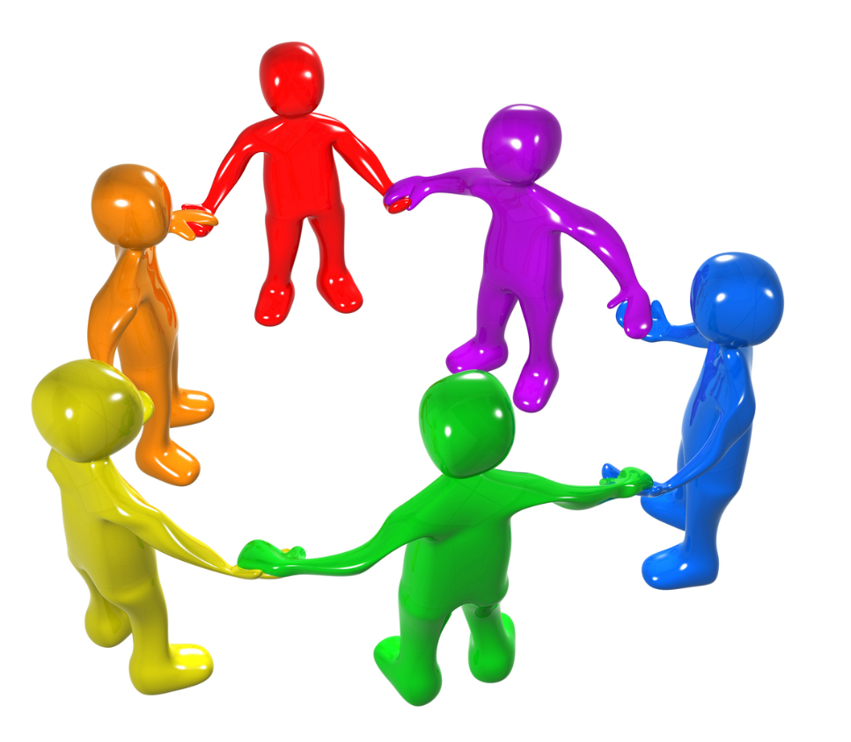
Shared Responsibility
The most important factor that ensures the cooperation of all these stakeholders is an informed and common understanding of the issues.
Shared understanding and responsibility are achieved through communication and mutual education, which can be effectively achieved by having all stakeholders participate in establishing the process that ensures safety and performance of medical devices.
©
Participants in Safety
dr. Chris R. Mol, BME, NORTEC, 2017

Slide 18
END
The creation of this presentation was supported by a grant from THET:
see https://www.thet.org/

